Slide 1
Introduction to Machine Learning

Slide 2
Machine Learning Process

Slide 3
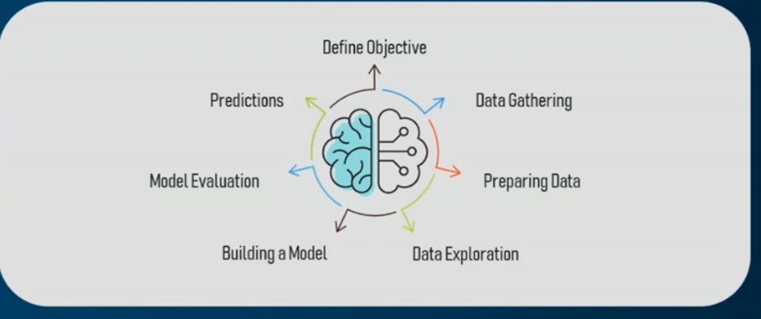
Machine Learning Process
Machine Learning process involves building a predictive model that can be used to find a solution for a problem statement.

Slide 4
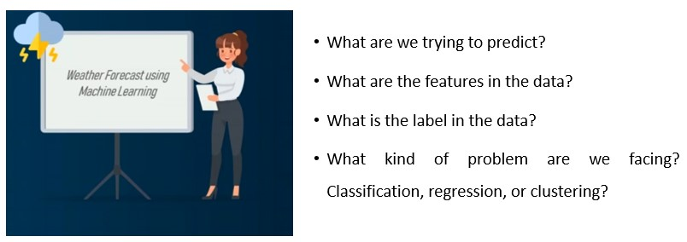
Step 1: Define the objective of the problem
For example, to predict the possibility of rain by studying the weather conditions.

Slide 5

Step 2: Data Gathering
Data such as weather conditions, humidity level, temperature, pressure, etc. are either collected manually or scraped from the web.

Slide 6
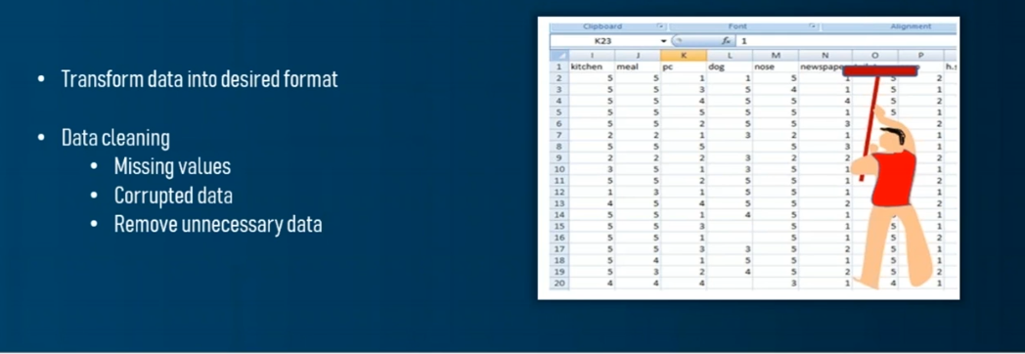
Step 3: Data Preprocessing
Data cleaning involves getting rid of inconsistencies in data such as missing values or redundant variables. It also includes encoding all the features that are string data type into numeric by a method known as one-hot encoding.

Slide 7

Step 4: Exploratory Data Analysis (EDA)
Data Exploration involves understanding the patterns and trends in the data. At this stage all the useful insights are drawn and correlations between the variables are understood.

Slide 8
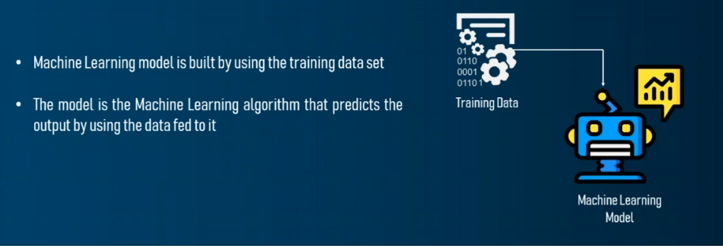
Step 5: Building a Machine Learning Model
At this stage a predictive model is built by using machine learning algorithms such as Linear Regression, Decision Trees, etc.

Slide 9
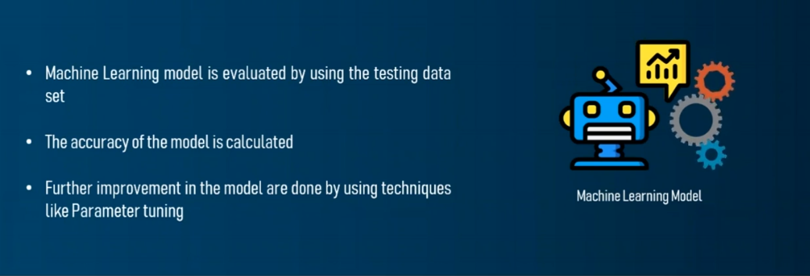
Step 6: Model Evaluation & Optimization
The efficiency of the model is evaluated by using metrics in classification or regression and any further improvement in the model are implemented.

Slide 10

Step 7: Predictions
The final outcome is predicted after performing parameter tuning and improving the accuracy of the model.

Slide 11


